Slide 1
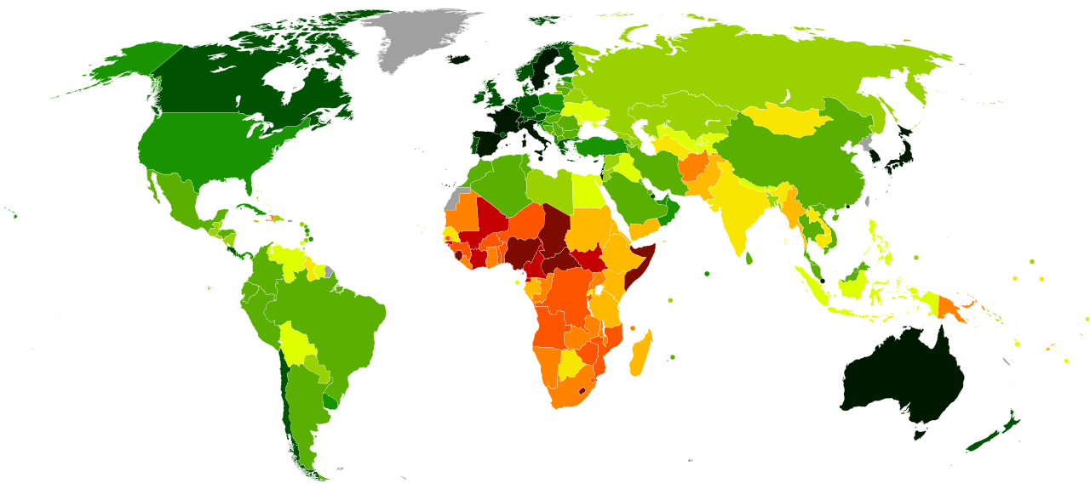
LIFE EXPECTANCY
Life expectancy of people in different countries with different diseases and habits

Slide 2
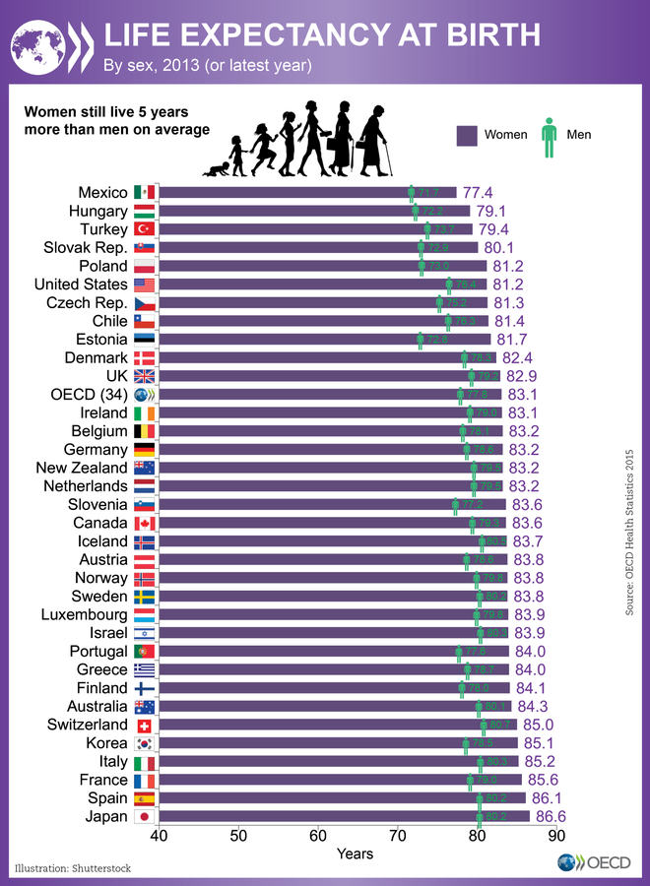
Team Information
Background and Motivation
Target audience
Problem statement
Project proposal
Analysis question
Dataset description
Visualization
References and sources

Slide 3

Team Information
Rutvik Paren Shah
Akhil Reddy Lekkala
Pavan Challagondla
Madhu Shashank Aapathi

Slide 4
Background and Motivation
Increases in life expectancy in most modern nations have generated questions regarding whether and to what degree people appreciate the possibility of extending their own lives in recent decades. In this regard, a new field of study has evolved that looks into the determinants, concomitants, and repercussions of longevity values and human desires for long life. It is a metric that sums up a country's mortality rate, allowing us to compare it across generations and spot trends. Its interpretation and meaning are even richer, and it can supply us with crucial information about a country's welfare state's progress. To summaries, it is a straightforward metric that is very synthetic, yet the data it relates to is frequently deceptive or misinterpreted. And, logically, disinformation will lead to misconceptions.

Slide 5
Who benefits from this project?
It is a statistic summarizes a country's mortality, allowing us to compare it over generations and examine trends. Its interpretation and meaning are richer, and it can supply us with critical information about a country's welfare state's level of development. It is a metric that sums up a country's mortality, allowing us to compare it over generations and spot trends. Its interpretation and meaning are even more decadent, and it can supply us with critical information about a country's welfare state's progress.

Slide 6
Target Audience
World Health Organization
Governments
UNO
Public
Media

Slide 7
What is the problem you are solving?
This metric measures the number of deaths and how untimely they occurred. For example, a person who dies at the age of 25 from homicide has greater YPLL than someone who dies at age 50 from cardiovascular illness. According to the study, each educational step achieved resulted in 1.37 fewer years of lost life expectancy. With this data, we get an idea of life expectancy and implement measures accordingly to increase life span depending on the factors affecting the life of people in different countries.

Slide 8
Why is the project important?
The outcomes obtained through this project will help us understand how different aspects affect the life expectancy of people. This project can amend things that affect life expectancy and lead to a better life. Life expectancy captures mortality across the entire life course, instead of the narrow metric of infant and child mortality, which focuses solely on mortality at a young age. It provides information on the average age of death in a population.

Slide 9
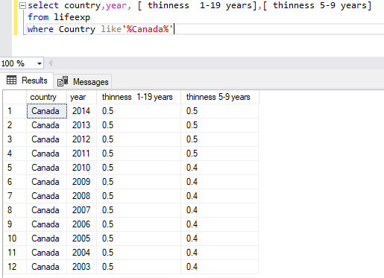
Query for Percentage of people effected with thinness issue for Canada region over years

Slide 10
Analysis Question
This Bar chart shows the percentage of people affected with thinness issues in the Canada region over the years.
This black represent the age group affected with the thinness of 5-9 years, and orange represents the age group affected with thinness between 1-19 years.
Here we conclude that we can see a decrease in thinness in age group 5-9 along the years from ages 1-19.

Slide 11
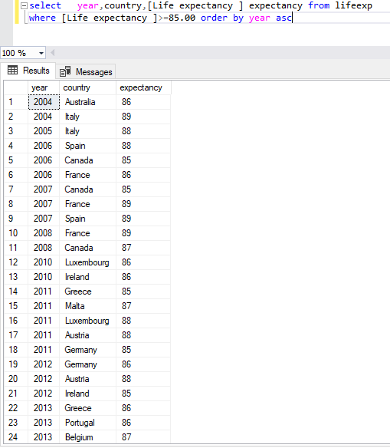
Query for people having high Life expectancy

Slide 12
Analysis Question
This Bar chart shows the percentage of people having high life expectancy in different countries over the years.
We conclude that a few countries like Germany, Belgium and Portugal had a high life expectancy in 2014, while countries like Ireland and Australia had low life expectancy.

Slide 13
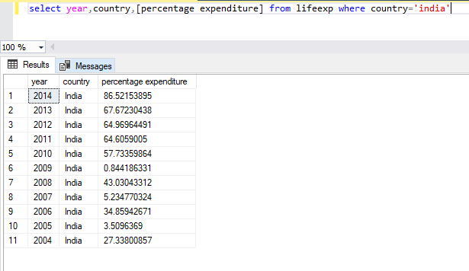
Query for Expenditure of people in India over different years

Slide 14
Analysis Question
This chart shows the percentage of people in India over the years.
We can see that Expenditure on health and self is increased drastically over the years.
We conclude that due to the increase of diseases, people are aware and spending more on health care and everything.

Slide 15
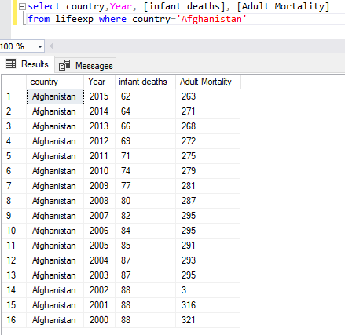
Query for Infant death rates and adult morality in Afghanistan

Slide 16
Analysis Question
This chart shows the number of deaths in Afghanistan over the years
Here we can see that Infant death rates and adult morality in Afghanistan decreased over the years.
We conclude there is a slight decrease in Infant death rates and adult mortality in Afghanistan due to awareness in people about health and better supplies.

Slide 17
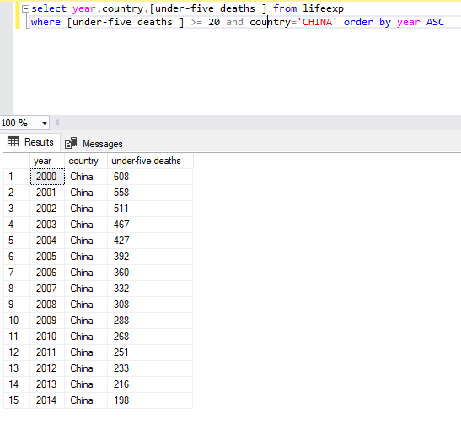
Query for deaths under five years of age in China over different years

Slide 18
Analysis Question
In this line chart we compared deaths of children under five years of age in China over different years.
Due to some factors like poverty, there were many children deaths in the year 2000, but the number came down due to the increase of facilities and better government.
We can conclude that deaths of children under five years in China is decreased by 60% in 14 years.

Slide 19

Visualization
We have performed our visualization in Tableau and Excel

Slide 20
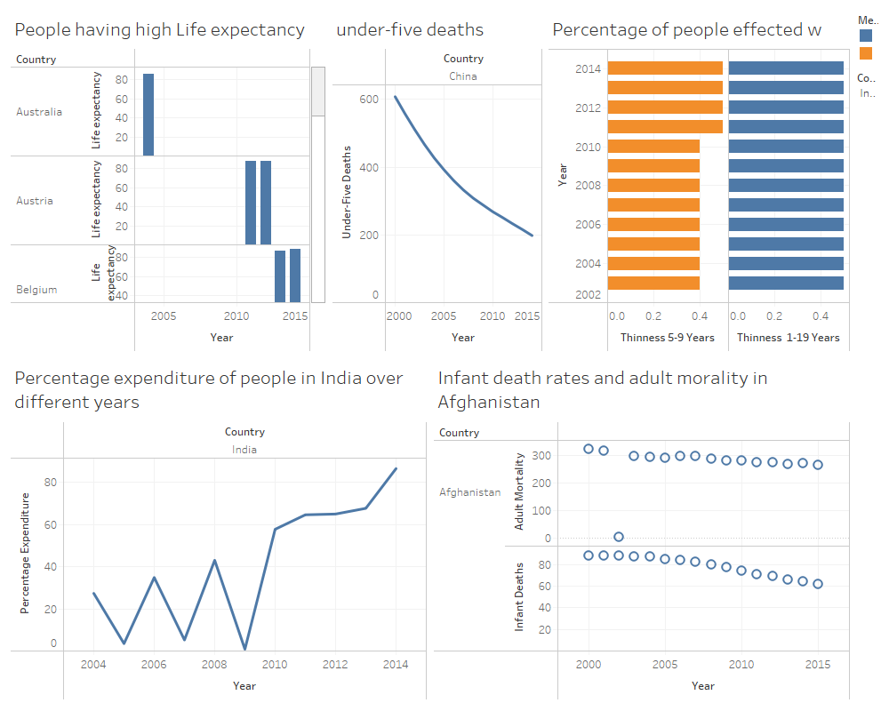
Visualization

Slide 21
Dataset description
We have taken this Life expectancy dataset from Github site
In this dataset there are 22 variables and 1650 instances.
We don’t have NULL values and blank space in the dataset so we did not perform any data cleaning
Link:
datasets/Life_Expectancy_Data.csv at master · selva86/datasets · GitHub

Slide 22
Reference and sources
https://news.yale.edu/2020/02/20/want-live-longer-stay-school-study-suggests
https://www.ncbi.nlm.nih.gov/pmc/articles/PMC6585880/
https://en.wikipedia.org/wiki/List_of_countries_by_life_expectancy
https://genus.springeropen.com/articles/10.1186/s41118-019-0055-0

Slide 23
THANK YOU

